Slide 1
Touching Soma Segmentation Based on the Rayburst Sampling Algorithm
Tianyu Hu,Qiufeng,XuWei,LvQian Liu
Neuroinform (2017) 15: 383. https://doi.org/10.1007/s12021-017-9336-y
王鹏
2018-11-29

Slide 2
1. Abstract

Slide 3
In this paper, they propose a soma segmentation method that combines the Rayburst sampling algorithm and ellipsoid fitting.
The improved Rayburst sampling algorithm is used to detect the soma surface;
The ellipsoid fitting method then refines jagged sampled soma surface to generate smooth ellipsoidal shapes for efficient analysis

Slide 4
2. Method

Slide 5
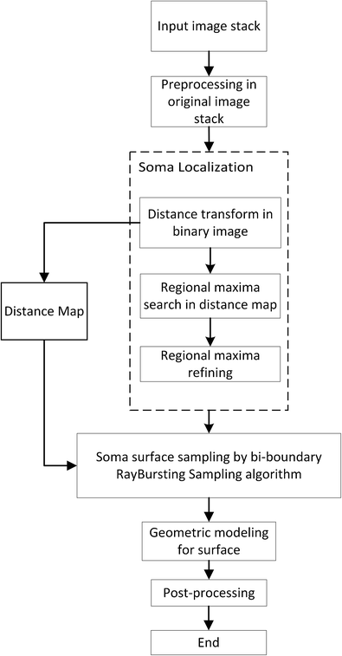
Overview

Slide 6
2.1 Image Preprocessing
Convert the resolution(0.5 μm × 0.5 μm × 2.0 μm) to isotropic (0.5 μm × 0.5 μm × 0.5 μm) by bilinear interpolation of slices of the fMOST dataset
In this study, the image foreground regions contained somata, and the background contained unrelated structures. In the fMOST data, the somata and several neurites generally had a relatively high intensity. We used a multi-scale LoG filter to enhance the soma regions.
An adaptive thresholding method (Otsu 1979) can be used to extract the image foreground.
Finally, holes in somata are filled, and small regions (less than 200 voxels) are deleted to refine the foreground.

Slide 7
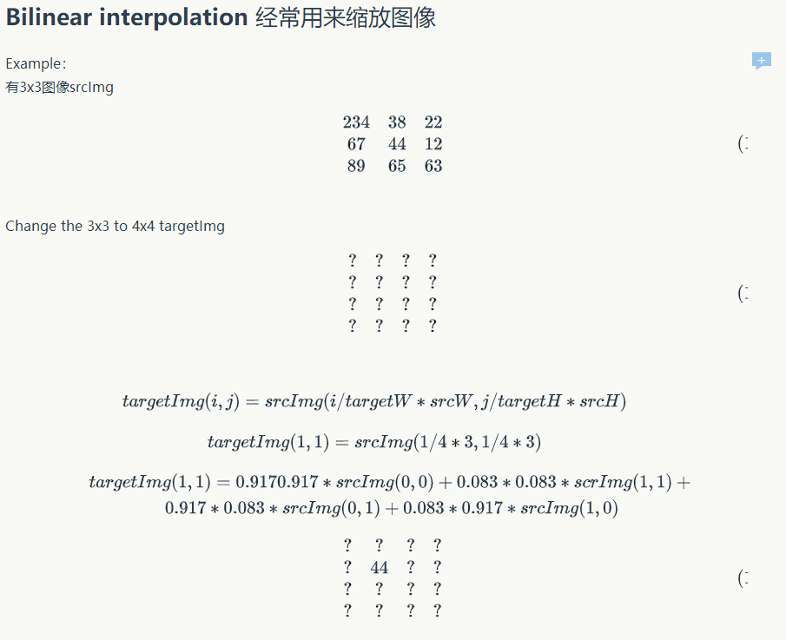

Slide 8
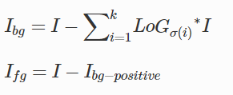
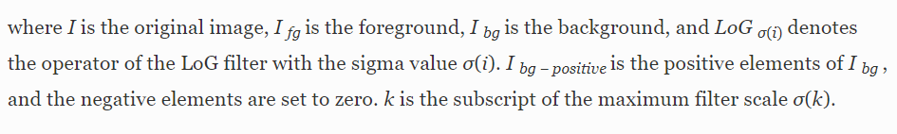


Slide 9
2.2 Soma Localization
Distance transform (DT) can be used to evaluate the shortest distance value from foreground voxels to background voxels.
The regional maxima in the distance map are candidates for soma centroids.
The H-dome transform (Vincent 1993) is used to eliminate reluctant regional maxima (regarded as jitter, as shown in Fig. 2) and provide candidate soma locations for surface detection

Slide 10
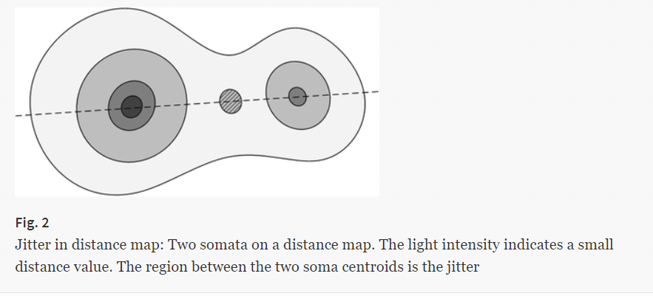

Slide 11
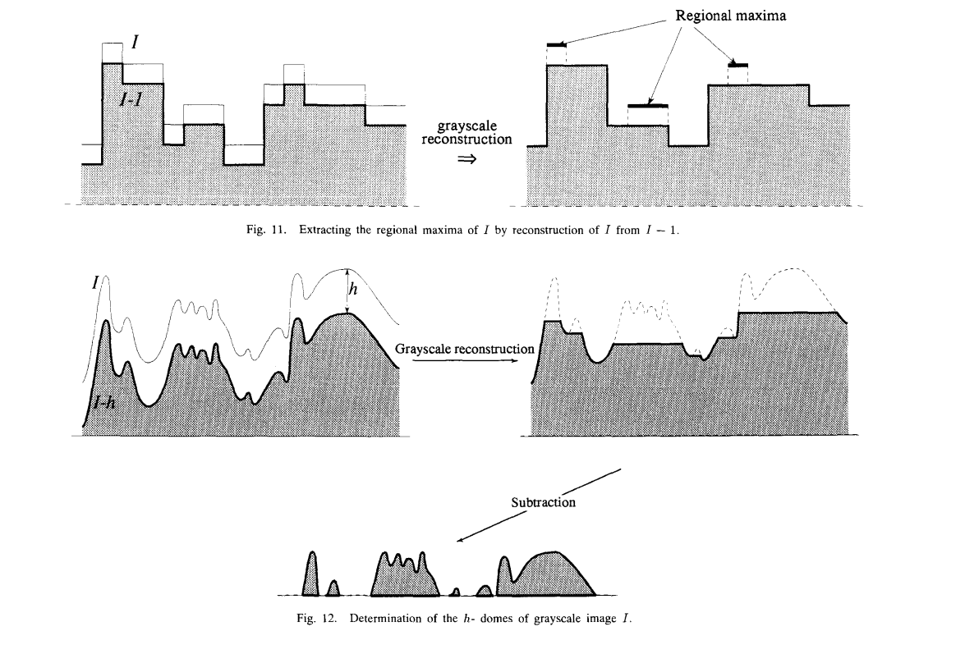
H-dome

Slide 12
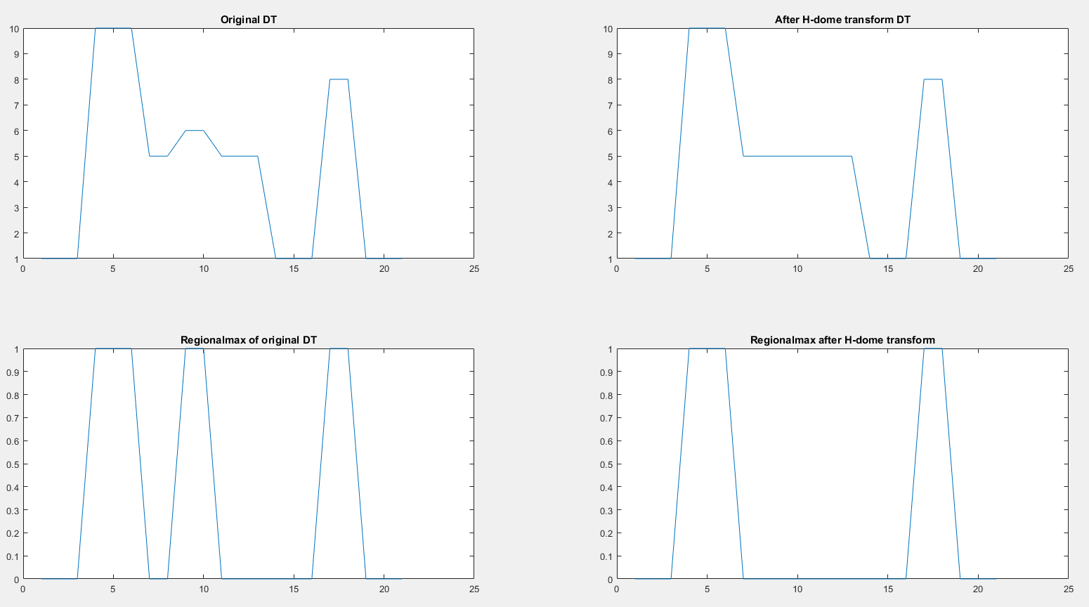
H-dome Example
h=1

Slide 13
2.3 Soma Surface Detection
The improved Rayburst sampling algorithm is based on DT instead of image intensity. The somata in the image stack from the fMOST dataset were solid with similar intensities, so the boundaries between touching somata were always unclear

Slide 14
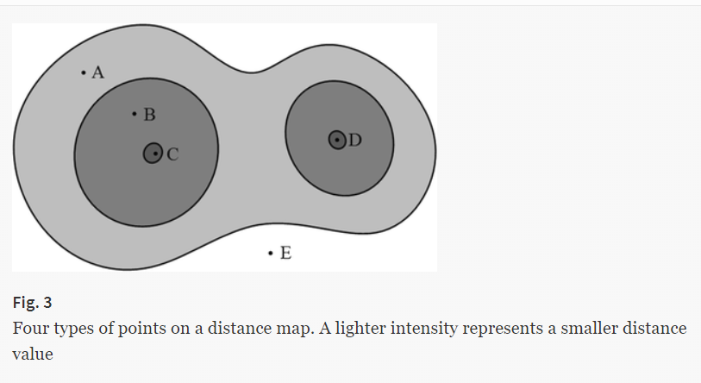
The four types of voxels in the foreground are as follows. (1) Type 1 is regional maxima, which include soma centroids and are regarded as the starting points for sampling rays; see regions C and D in Fig. 3.
(2) Type 2 is voxels around the soma centroid that do not stretch to other touching somata to form the distinct region of one soma; see region B in Fig. 3.
(3) Type 3 is voxels of region A between the boundary region B and background. This region stretches from one soma to the other of a touching soma pair. This region is closer to the background than type 2. It contains the touching parts of two somata as well as uncertainty; see region A in Fig. 3.
(4) Type 4 is background voxels; see region E in Fig. 3.

Slide 15
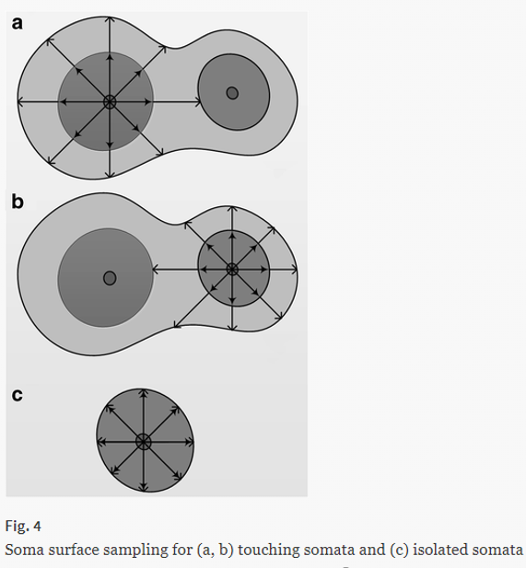
we defined two kinds of boundaries for sampling rays to detect the soma surface.:
The inner boundary is between the type 2 and 3 regions for one soma; see the inside arrows in Fig. 4(a).
The outer boundary is between a type 3 region and background; see the outside arrows in Fig. 4(a). As shown in Figs. 4(a)–(c), the outer boundary reflects the final contour for isolated and touchi
The stopping conditions for sampling rays can be set as follows:
the rays reach the background voxels while the distance value is zero,
rays reach the regional minima in the touching region while the distance value increases.ng somata.

Slide 16
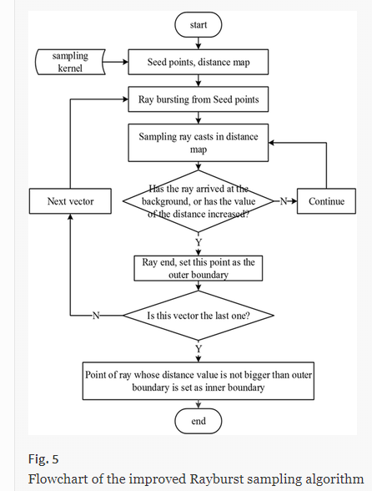

Slide 17
2.4 Soma Shape Fitting
We applied a numerically stable method for least squares ellipsoid fitting based on the ellipsoid fitting method (Li and Griffiths 2004) and enhanced direct ellipsoid fitting method (Maini 2006) to point data sampled with the Rayburst sampling algorithm.

Slide 18
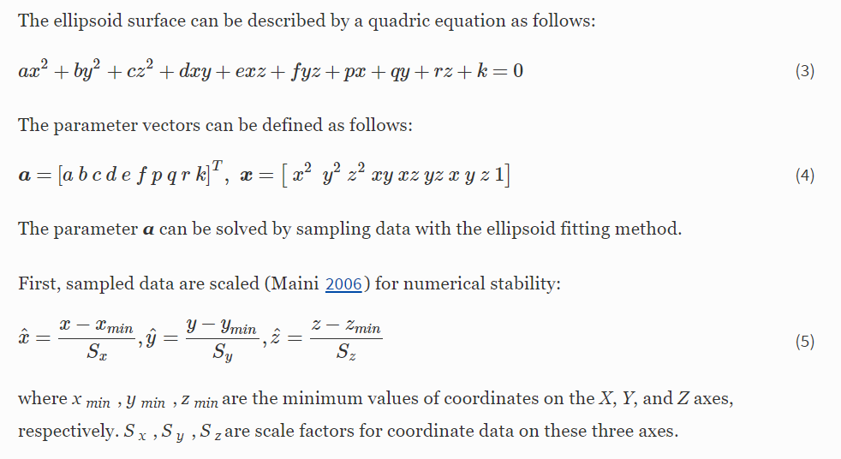

Slide 19
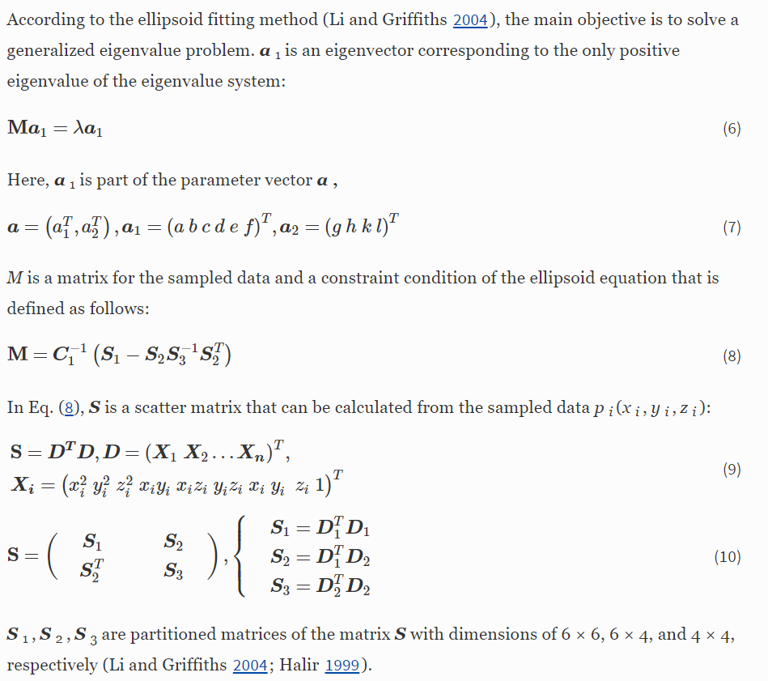

Slide 20
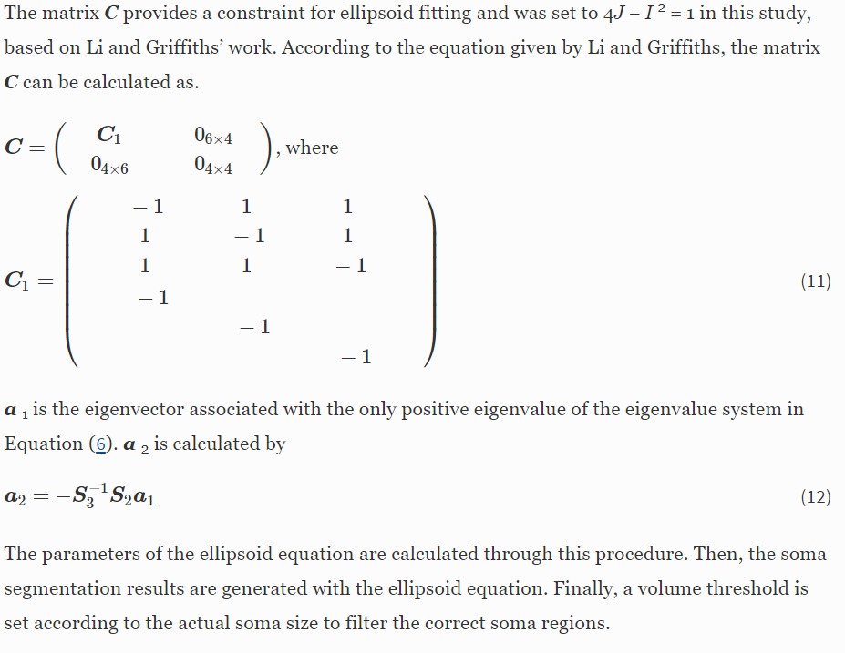

Slide 21
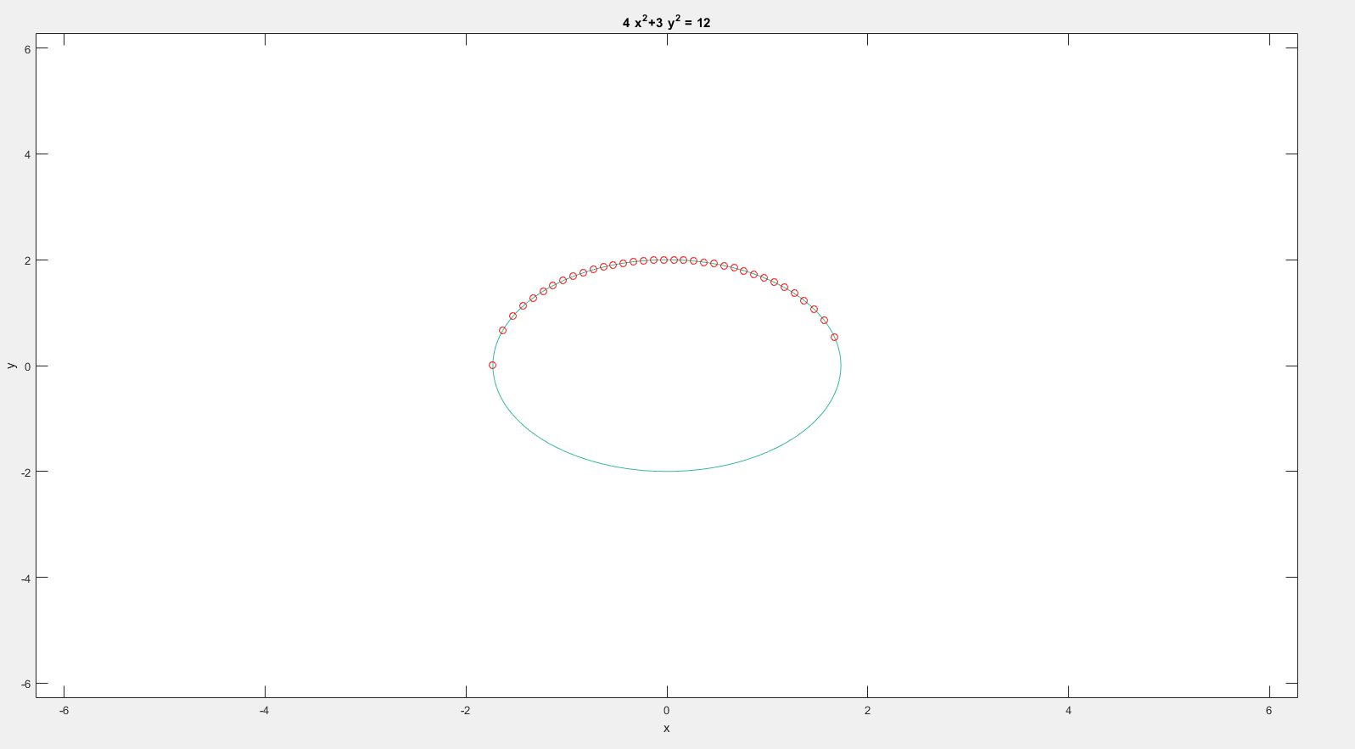
举个二维椭圆拟合的例子

Slide 22
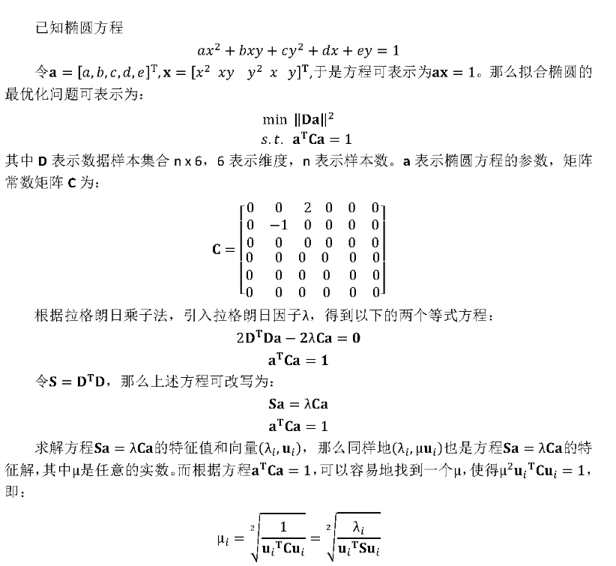

4ac-bb>0
退化为最小化约束条件
4ac-bb=1

Slide 23
Result

Slide 24
The proposed method was validated on a workstation (Intel Corel i7-4810MQ 2.8 GHz, 16 GB RAM, NVIDIA Quadro K3100 M, Microsoft Windows 7). The test data contained four image stacks: three were from the fMOST system labeled with green fluorescence (Gong et al. 2013) and the last was from VANO (Peng et al. 2009). The performance of the proposed method was evaluated in terms of soma localization or segmentation for the datasets. Table 1 presents the main parameters of our proposed method.

Slide 25
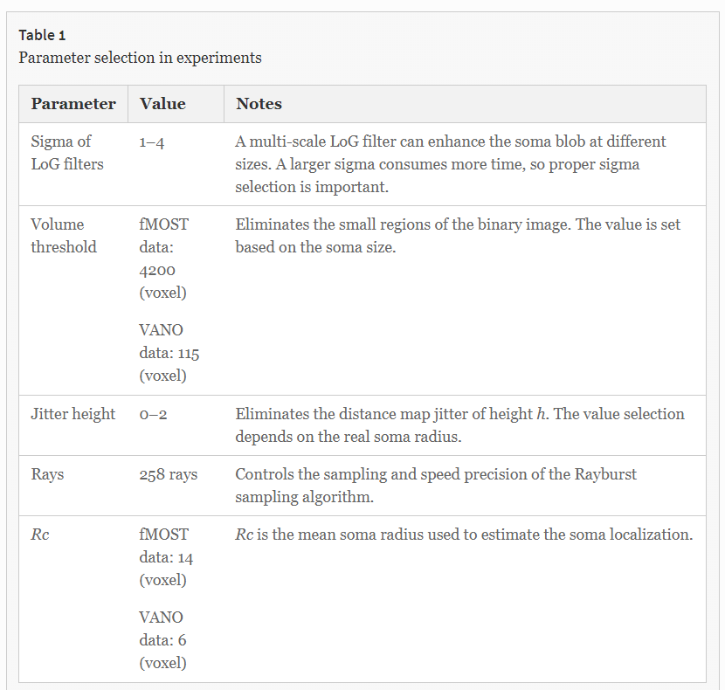

Slide 26
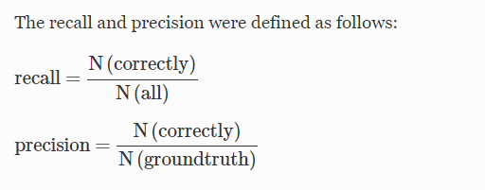
3.1 Evaluation of Soma Localization
N(correctly) denotes the number of somata correctly located by the automatic algorithm and N(groundtruth) is the soma number of the ground truth. N(all) represents the number of somata located by the automatic algorithm.
The image stack from VANO contained 80 cells and had dimensions of 236 × 249 × 105 voxels.
The soma segmentation had a runtime of 4.8 s with a recall of 96.2% and precision of 95.0%.

Slide 27
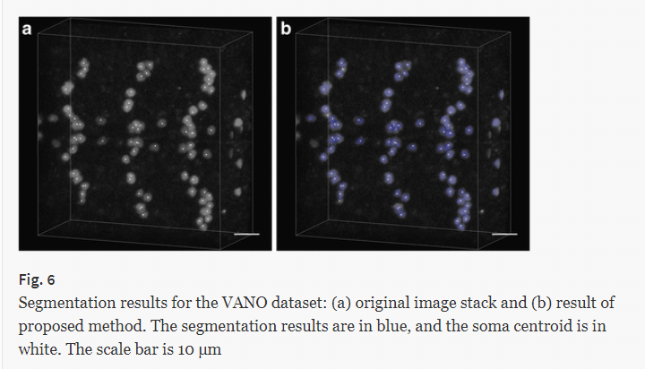

Slide 28
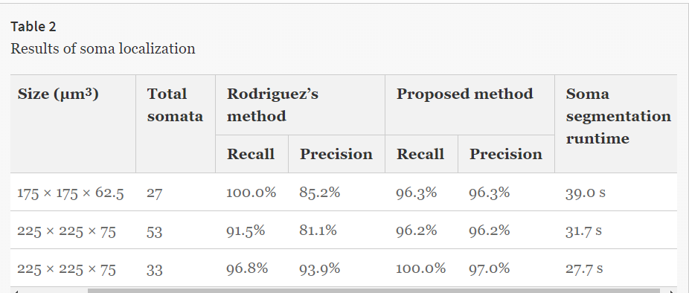

Slide 29
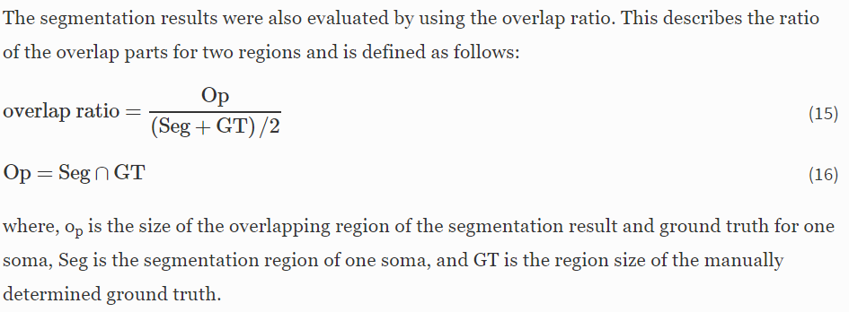
3.2 Evaluation of Soma Segmentation

Slide 30
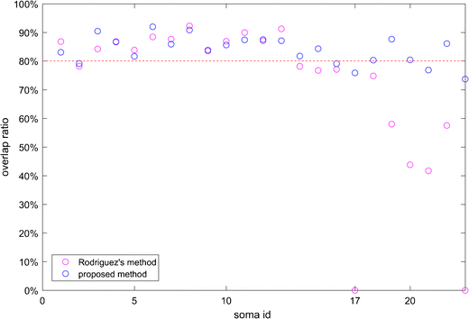

Slide 31
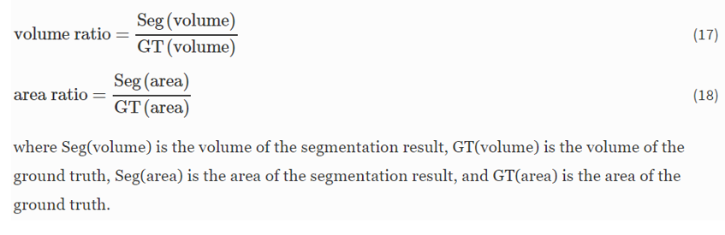
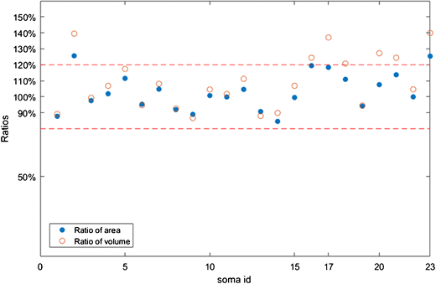

Slide 32
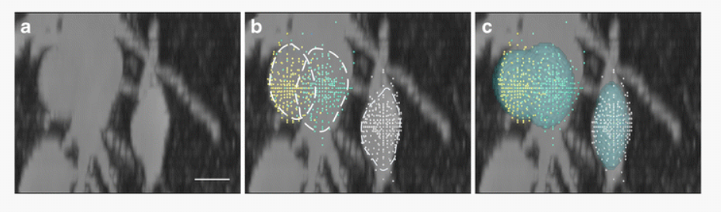

Slide 33
Conclusion

Slide 34
This paper proposes an automatic soma segmentation method suitable for datasets with touching soma distributions. The proposed method contains three main parts:
soma detection based on DT and local maximum searching and refining;
an improved Rayburst sampling algorithm for isolated and touching soma surface detection; and
ellipsoid fitting to generate the segmentation results.
Notes:
（1）基于DT的局部检测和局部最大搜索和精化; （2）改进的Rayburst采样算法，用于隔离和触摸体细胞表面检测; （3）椭球拟合生成分割结果。

Slide 35
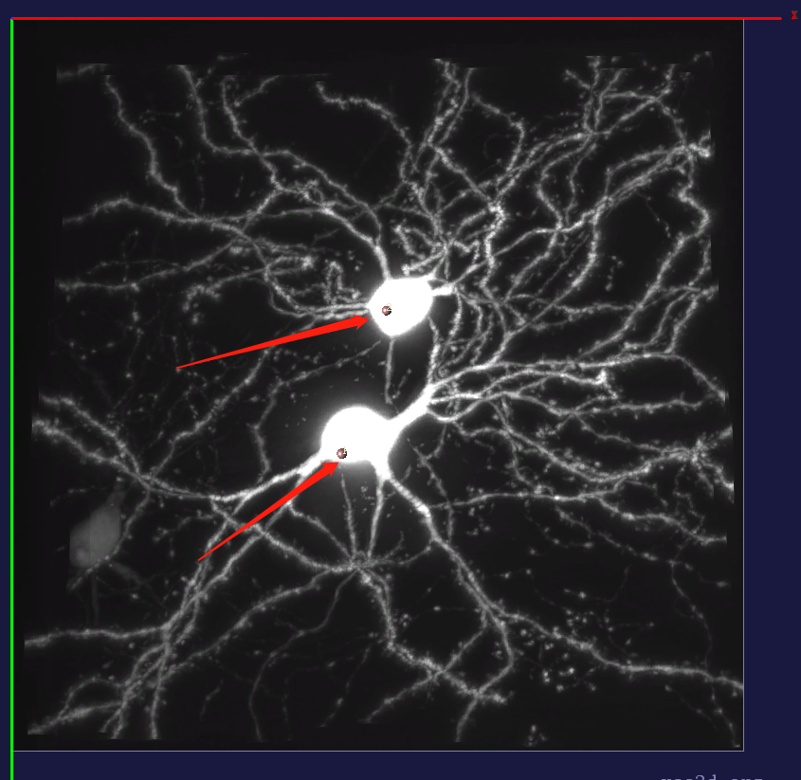
Test 17302-0

Slide 36
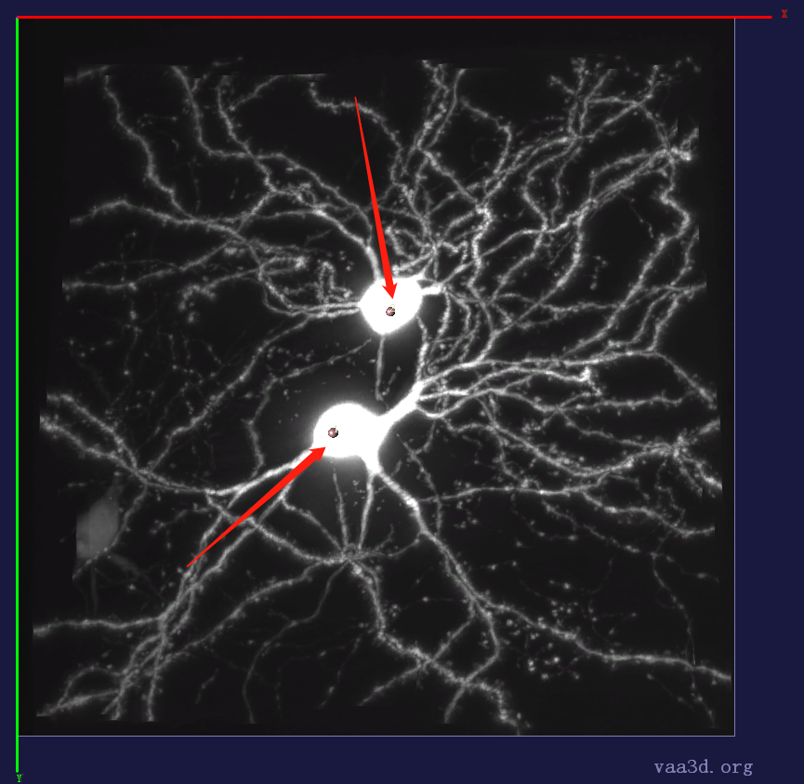
Test 17302-2

Slide 37
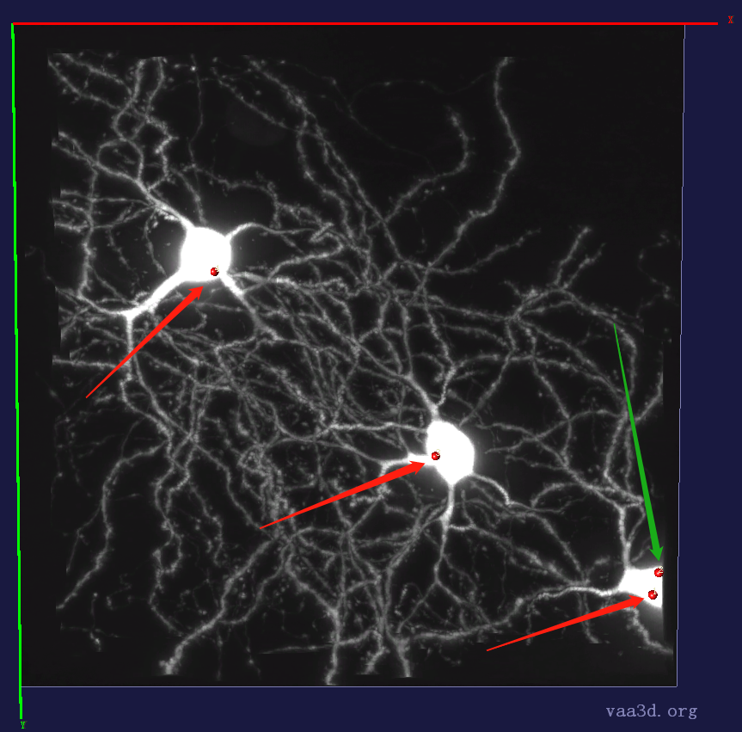
Test 17302-3 (error)

